Slide 1


Arian Larios
7/22/2022

Slide 2

Outline
Executive Summary
Introduction
Methodology
Results
Conclusion
Appendix

Slide 3
Executive Summary
Summary of methodologies
Using APIs to collect data
Web Scraping
Data Wrangling
Exploratory Data Analysis
Interactive Dashboard
Predictive Analytics
Summary of all results
Analysis Results
Machine Learning Results

Slide 4
Introduction
Project background and context
The purpose of this project is to determine if we can perform rocket launches at a lower cost than Space X can. We can accomplish this by analyzing data to determine whether the first stage of our launch will be successful. The result of this project will be a machine learning pipeline that can predict if these launches will be successful.
Problems you want to find answers
Which variables affect the result of our launches?
How can we increase the chances of a successful launch?
Are there any risks or opportunities?

Slide 5

Section 1

Slide 6
Methodology
Executive Summary
Data collection methodology:
Data was collected using SpaceX’s API and web scraping.
Perform data wrangling
Perform exploratory data analysis (EDA) using visualization and SQL
Perform interactive visual analytics using Folium and Plotly Dash
Perform predictive analysis using classification models

Slide 7
Data Collection
Describe how data sets were collected.
Some of the data was collect via SpaceX’s API.
Then I converted the JSON response content into a Pandas data frame for future analysis.
I cleaned the data and checked for any missing values.
I used the Beautiful Soup library to web scrape data for Falcon 9 launches from Wikipedia.
Beautiful Soup is used to extract the HTML table and convert it to a Pandas data frame as well.

Slide 8
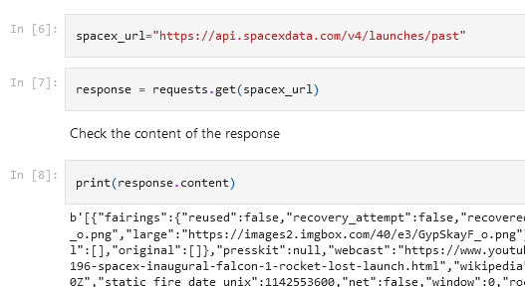
Data Collection – SpaceX API
I used the get request function to collect data from the Space X API
https://github.com/Arianlg/Applied-Data-Capstone-Project/blob/main/Data%20Collection%20API.ipynb

Slide 9
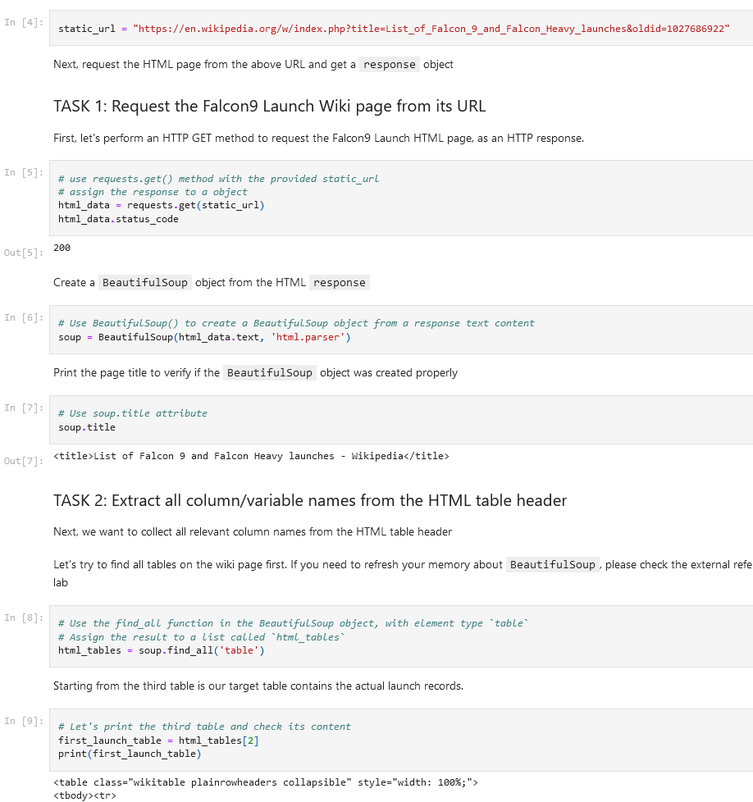
Data Collection - Scraping
I used beautiful soup to web scrape the Falcon 9 Launch data.
https://github.com/Arianlg/Applied-Data-Capstone-Project/blob/main/Data%20Collection%20with%20Web%20Scraping.ipynb

Slide 10
Data Wrangling
I performed exploratory data analysis to better understand the data.
I calculated the total number of launches at each site and the number of orbits.
https://github.com/Arianlg/Applied-Data-Capstone-Project/blob/main/Data%20Wrangling.ipynb

Slide 11
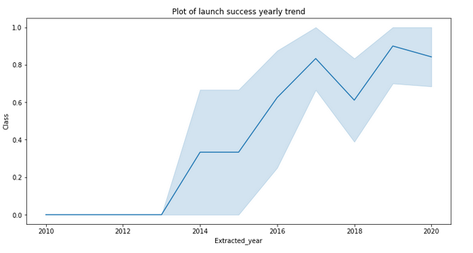
EDA with Data Visualization
I used bar and line graphs to understand the relationship between variables and understand trends over time.
https://github.com/Arianlg/Applied-Data-Capstone-Project/blob/main/Exploratory%20Data%20Analysis.ipynb

Slide 12
EDA with SQL
I use SQL to query the names of launch sites in each mission, total payload mass carried by boosters, and the total number of successful for failed missions.
https://github.com/Arianlg/Applied-Data-Capstone-Project/blob/main/Exploratory%20Data%20Analysis%20with%20SQL.ipynb

Slide 13
Build an Interactive Map with Folium
I marked the launch sites on a map and noted which ones were successful and which ones failed.
It was also important to mark the distance from each launch site.
https://github.com/Arianlg/Applied-Data-Capstone-Project/blob/main/Folium%20Dashboard.ipynb

Slide 14
Build a Dashboard with Plotly Dash
I created an interactive dashboard using Plotly
I used visualizations such as pie charts to derive insight from the data.
https://github.com/Arianlg/Applied-Data-Capstone-Project/blob/main/Dashboard.py

Slide 15
Predictive Analysis (Classification)
I used numpy and pandas to transform the data and split the data into training and testing data.
It is important to use a few machine learning algorithms and then evaluate to determine which one is the most accurate.
https://github.com/Arianlg/Applied-Data-Capstone-Project/blob/main/Machine%20Learning%20Prediction.ipynb

Slide 16
Results
Exploratory data analysis results
Interactive analytics demo in screenshots
Predictive analysis results

Slide 17

Section 2

Slide 18

Flight Number vs. Launch Site
Based on the plot, we can see that the larger the flight number, the greater the success rate.

Slide 19

Payload vs. Launch Site
The greater the payload mass, the higher the success rate for the rocket.

Slide 20

Success Rate vs. Orbit Type
The bar chart shows that ES-L1, GEO, HEO, SSO are the most successful.

Slide 21

Flight Number vs. Orbit Type
The plot below shows that there is a relationship between the success of a mission and the number of flights regarding the LEO orbit.

Slide 22

Payload vs. Orbit Type
The heavier the payload, the more chance of success.

Slide 23

Launch Success Yearly Trend
The success rate has constantly increased since 2013, with a slight dip in 2018.

Slide 24

All Launch Site Names
I used the Distinct function in SQL to query the names of the launch sites.

Slide 25

Launch Site Names Begin with 'CCA'
I used a Where clause to find launch sites that contained “CCA”

Slide 26
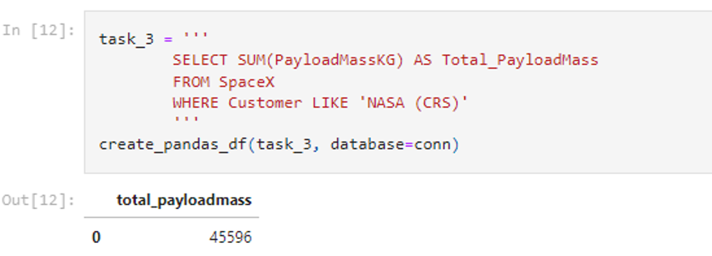
Total Payload Mass
I used the Sum function to calculate the total payload mass.

Slide 27

Average Payload Mass by F9 v1.1
I used the Average function and Where clause to calculate the average payload mass for FP v1.1’s.

Slide 28

First Successful Ground Landing Date
I used the Minimum function to find the date of the first successful ground landing date.

Slide 29

Successful Drone Ship Landing with Payload between 4000 and 6000
I used multiple Where clauses to filter the data to just successful landings with a payload between 4000 and 6000.

Slide 30

Total Number of Successful and Failure Mission Outcomes
Two separate queries are used to sum the total successes and failures.

Slide 31

Boosters Carried Maximum Payload
I used a subquery to determine the booster that could carry the max payload.

Slide 32

2015 Launch Records
A combination of Where, LIKE, and BETWEEN are used to pull the 2015 lauch records.

Slide 33

Rank Landing Outcomes Between 2010-06-04 and 2017-03-20
The Group By and Order By functions are used to filter the data.

Slide 34

Section 3

Slide 35
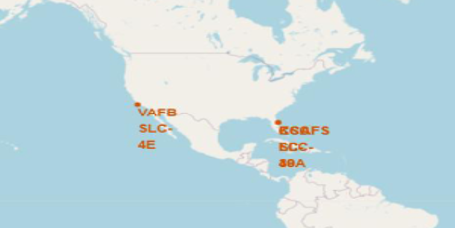
Launch Sites
The screenshot below shows that all launch sites are within the United States.

Slide 36
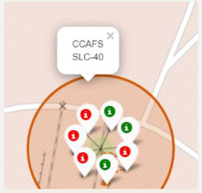
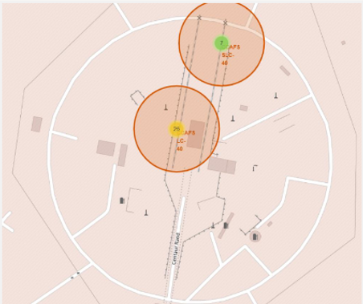
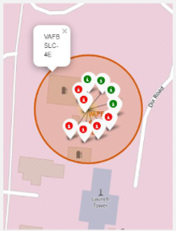
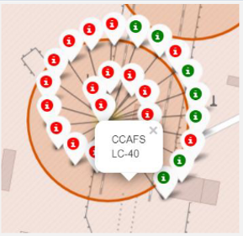
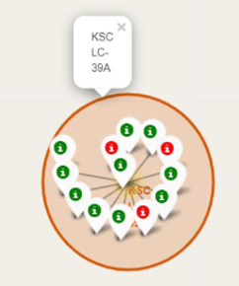
Map with Markers.
Green markers are used to signify successful launches, and red markers are the failures.

Slide 37

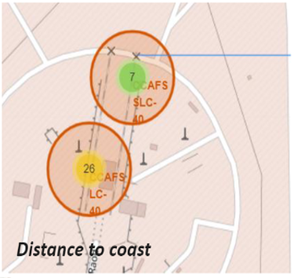
Distance from Launch Sites to Landmarks
The maps show that launch sites are not close to railways nor highways, but are close to coastlines and far enough away from cities.

Slide 38

Section 4

Slide 39
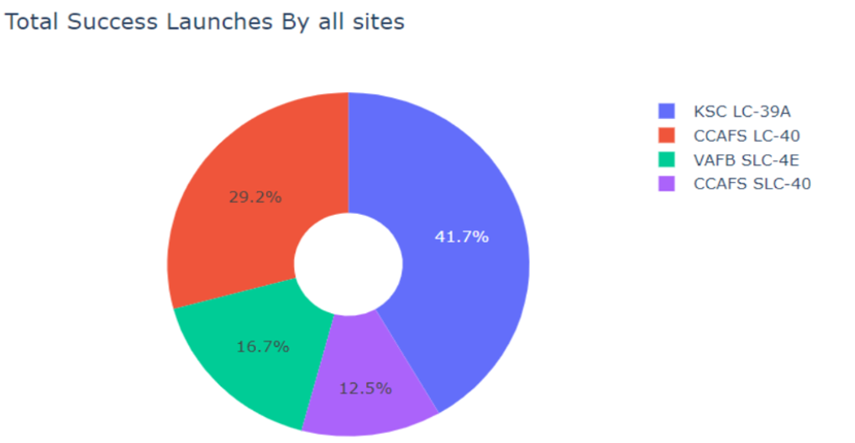
Pie Chart Success Rate
The pie chart shows that the KSC LC-39A

Slide 40
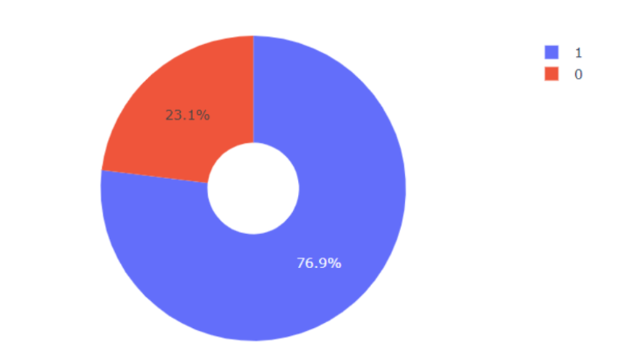
Pie Chart Success Ratio
The KSC LC-39A achieved a higher success rate.

Slide 41
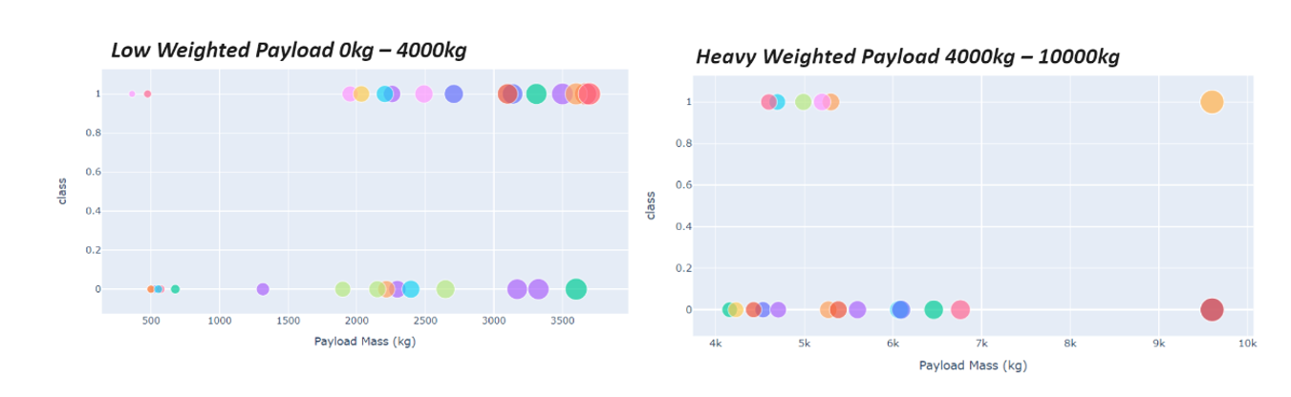
Scatter Plot – Payload vs Launch Outcome
The success rate for lower weights is higher than higher weighted rockets.

Slide 42

Section 5

Slide 43

Classification Accuracy
The decision tree classifier is the best model.

Slide 44

Confusion Matrix
This classifier can distinguish between different classes.

Slide 45
Conclusions
The larger the flight number, the higher chance of success.
Our rockets did not become successful until 2013.
The ES-L1, GEO, HEO, SSO, and VLEO were the most successful.
The decision tree classifier is the most accurate model.

Slide 46


